Slide 1

Mobility and Agility
Dimension Data’s Global Contact Centre Benchmarking Report 2012 – Briefing for the CCMA

Slide 2
Why benchmarking
The Report
Top line results from 2012
Plans for 2013
Taking Part

Slide 3
Clients tell us why they Benchmark
“As input to our annual plan for the call centre”
Contact Centre decision-makers know about the fundamental and important role that the contact centre plays within their organisation.
More and more, the necessity to demonstrate the value of the contact centre and to harness optimal and continued value is becoming critical to our clients.
“To identify operational areas to improve”
“To compare ourselves with our peers in order to focus development activities”
“To compare us industry best practice”
“To align customer management to your business strategy”

Slide 4
Three key benefits in understanding contact centre practices and performance
Capability
Operations
The correct technology
must be in place
to assist staff to work efficiently with
management enabling
career succession
and growth
It is critical
that processes are
correctly documented
and continuously
updated to ensure
optimal operational performance
Staff
Management
practices
Technology
Process
efficiency
Operational
performance
Customers
Customer retention
Customer satisfaction
Customer attrition
Customer Management
is becoming increasingly important
in order to ensure a competitive advantage

Slide 5
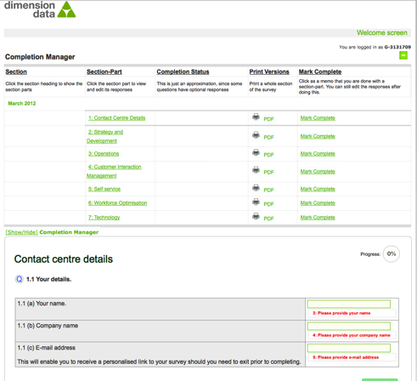
Two products

Slide 6
Lots of collateral…

Slide 7
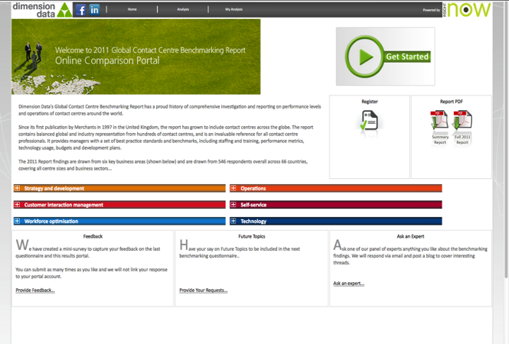
…a great Analysis Portal…
Notes:
Would it be better to paste in analysis page?

Slide 8

The Global Contact Centre Benchmarking Report
Annual global benchmarking survey of customer management and the contact centre
15 years of trends, performance data and best practice information
Report provides Observation, Implication and Recommendations on over 350 performance metrics
Report supported by online benchmark comparison portal (filters by region/sector/size/type)
Six Core Review Areas
Technology
Strategy & Development
Operations
Interaction Management
Workforce Optimisation
Self-service
Notes:
Some quick facts about the 2012 Report
A single point of reference on the key aspects concerning customer management
Widely acknowledged as the most useful, authoritative and comprehensive
research study of its kind
Merchants - 30-year history of customer management excellence

Slide 9
Why benchmarking
The Report
Top line results from 2012
Plans for 2013
Taking Part

Slide 10

2012 Report theme and emerging trends
Mobility and Agility - transforming customer management
Increase
efficiency
Agility
Cloud
Self-service
Multi-channels
Improve service
Complexity
Increase sales & CLTV
Mobility
Missed opportunity
Customer needs
Social media
Process gaps
Technology developments

Slide 11



About the 2012 Report
637 companies globally took part in this years survey
Representation from 11 sectors
Participation from 72 countries
80% captive 20% Outsourced
Supported by 29 of the worlds most important industry associations
Notes:
637 participants – our highest ever response, and up 17% from last year.
Closer ties with associations and industry groups are enabling greater reach both in regards to securing respondents but also sharing the findings of the report and our collateral.

Slide 12
Regional representation
Percentage | n | 637
Africa and Middle East | 21.4
Americas | 23.5
Asia-Pacific | 10.4
Australia and New Zealand | 14.4
Europe | 11.0
United Kingdom | 19.3
The 2012 research saw us achieve our highest sample pool to date in the 15-year history of the Global Contact Centre Benchmarking Report. Consequently, the depth of our results across all regions and industry sectors is among the most robust it’s ever been.
We have again split out the UK results from the mainland Europe sample. A similar approach was taken for Australia and New Zealand from the Asia-Pacific sample, as we aim to provide as much granularity as possible.

Slide 13
Representation by industry
Percentage | n | 637
Financial Services [banking, insurance, broking, etc.] | 21.3
Service Providers and Telecommunications [ISPs, mobile and fixed telecommunication, etc.] | 14.3
Technology | 11.4
Government and Education | 11.0
Consumer Goods and Retail | 8.8
Travel and Transportation [logistics, freight, travel agents, etc.] | 7.0
Healthcare and Pharmaceuticals | 6.0
Utilities and Energy [electricity, gas, water, etc.] | 5.7
Business Services [legal, research etc.] | 5.4
Automotive and Manufacturing | 5.0
Media and Entertainment | 4.1
Participants were allowed to select more than one industry sector if they operate in multiple sectors (as is often the case for outsourcers). Of all operators, 14.4% report a multi-sector solution capability.
As in previous years, the top four participating sectors are Financial Services, Service Providers and Telecommunications, Technology and Government and Education. While Financial Services remain our largest sample group, the general split between sectors is now more balanced than in previous years.
Notes:
As in previous years, the top four participating sectors are Financial Services, Service Providers and Telecommunications, Government and Education, and Technology – itself a fair reflection of the sector penetration across our industry. While Financial Services remain our largest sample group, the general split between sectors is now more balanced than in previous years.

Slide 14
Number of employees
How many employees do you have within your own contact centre (e.g. the contact centres being reviewed in this survey?
n | 630
Overall a more balanced representation than 2011. More than 50% of respondents are from contact centres with 101 or more employees. The percentage of operations with over 1,000 seats is up slightly on the last review.
Captive (in-house) operations provide almost 79.6% of our sample with 20.4% from outsourced solutions.

Slide 15
Why benchmarking
The Report
Top line results from 2012
Plans for 2013
Taking Part

Slide 16
How the role of the contact centre has changed
1990s
2000s
2010s
Provide improved customer access
Broadening
channel access
Supporting
other channels
(not always first choice)
Replacing
face to face
Channel migration
for cost reduction
Part of a
multi-channel experience
Process optimisation
Migrating to self service channels

Slide 17
Evolution of non face to face interactions
Notes:
We produced this slide last year from aggregated data taken from previous Benchmark Reports. It clearly shows the evolution of customer contact away from traditional agent and email channels. Should highlight that we’re not saying overall agent contacts are falling, rather the representation is diminishing.

Slide 18








Four key themes from this year’s report
Rise of Mobility & Social Media
How organisations respond
Keeping pace in a multi-channel world
Whilst dealing with legacy systems
Who’s keeping score with self service?
When did you last check your IVR?
Let’s move to the enterprise!
One size doesn’t fit all

Slide 19


Mobility, Social Media and Cloud
More haste, less speed
Cloud Nirvana? Not Exactly

Slide 20

Mobility & Socal Media
A customer revolution enabled by mobility, but fueled by social media
Consumers are dictating their channels of choice
33.1% are supporting social media – almost double that reported in 2011
46.3% will be using web chat to direct Internet traffic within 12 months, by which time social media presence will have increased by another 43.5%.

Slide 21

How are organisations responding?
The big question is how effectively organisations can respond to this evolution
54.5% of providers say their current capability is still in a learning and developing phase
The challenge is considerable and often the starting position is weak: only 6.7% believe their operations highly advanced

Slide 22

Keeping pace with a multi-channel world
Keeping up with ‘business as usual’ challenges is hard enough…..
but new channel expectations are putting contact centres under more pressure
80.6% working towards CC as differentiator
Challenged by expanding responsibilities to keep up with current and future efficiency and effectiveness expectations

Slide 23
Dealing with legacy systems
The big challenge for many contact centres is ageing technology, which is expensive to maintain and costly to upgrade
Contact technology strategies are migrating into an enterprise customer management strategy – now at 66.8%
This is transforming how technology is sourced, implemented and supported. Flexibility, agility and mobility are key and cloud is on the radar.
Notes:
. These results clearly highlight an industry transition point in terms of accountability and responsibility for contact centre business requirements and the sourcing of technology.

Slide 24

The customer revolution – more haste, less speed
The mega trends of mobility the prevalence of Internet-based services including video, web-chat, and social media are completely transforming the way we communicate with organisations
This is causing a rush to implement new channels to meet customer demand, rather than at their own convenience
Notes:
Historically, organisations set the tone in how they collaborated with their customers.

Slide 25

Who’s keeping score with self –service?
Self-service channels such as IVR the most commonly used channel ….
…..but the absence of cost measurement is staggering
Only 27.9% of contact centres are measuring Internet interaction costs,
Of those companies using a self-service channel such as speech, SMS, web chat or social media, nearly half don’t collect any customer feedback at all

Slide 26
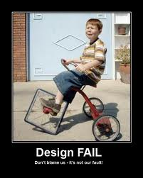
When did you last check your IVR?
There is considerable neglect of IVR self-service
Over half (50.6%) don’t schedule any regular IVR process reviews
and nearly three quarters (72.4%) are needlessly frustrating their customers by not passing information collected within the IVR to agents.

Slide 27

Let’s move to the enterprise
The combination of ageing, high maintenance and poor functionality in IT is forcing change
Contact technology strategies are progressively migrating into the wider enterprise customer management strategy – now at 66.8%
and this is transforming how technology is sourced, implemented and supported. Flexibility, agility and mobility are key and cloud is on the radar.
Notes:
. These results clearly highlight an industry transition point in terms of accountability and responsibility for contact centre business requirements and the sourcing of technology.

Slide 28

One size doesn’t fit all
Just 59% believe their current core infrastructure components - CRM, CTI, routing, self-service, WFM etc. - meets their current needs…
….while for future needs, this figure drops to just 13.8%.
30.4% of contact centres report they have no, or only a limited, involvement in the design of business requirements for new technology solutions.
Of these, 7.2% state that it’s purely a contact centre decision
Notes:
. These results clearly highlight an industry transition point in terms of accountability and responsibility for contact centre business requirements and the sourcing of technology.

Slide 29

Cloud Nirvana? Not Exactly
Organisations are waking up to the possibilities of utility and consumption based models for technology….
….but its not a case or either-or. Most expect a hybrid or blended solution
Cloud has doubled in its importance from the 2011 results, with flexibility and compliance with the enterprise technologies the driving force
BUT…organisations will need to find a way to use, re-use and upgrade existing technologies. Any Cloud migration will likely be gradual (despite the hype) and in appreciation that Cloud is not an all-or-nothing decision
Notes:
. These results clearly highlight an industry transition point in terms of accountability and responsibility for contact centre business requirements and the sourcing of technology.

Slide 30
Why benchmarking
The Report
Top line results from 2012
Plans for 2013
Taking Part

Slide 31
What’s new for 2013
Multi-channel, multi touchpoint:
  Voice, digital
  Social media and mobility
  Technology models
Collateral: outputs
  Help Desk Report
  Regional summary report for CCMA member participants
  Online portal
    including headline commentary,
    Online Library
Newsletter: May 2013
  Thought leadership articles
  Recurring Benchmark Bites
  Q&A
  Latest news, events, social media & content links
World Wildlife Fund:
  Partnership to promote business environmental sustainability
  Contribution of $5 for every completed questionnaire

Slide 32
Why benchmarking
The Report
Top line results from 2012
Plans for 2013
Taking Part

Slide 33
Taking part – the full survey
Contribute to the research and receive a FREE printed copy of the 2013 Report,
a value of USD 1,500
Participate here: https://2013.ccbmsurvey.com/?t=CCU
LIMITED OFFER: Complete the questionnaire within 10 days…
to immediately receive a digital copy of the 2012 report AND
gain access to an online Benchmark Comparison Portal, where you can filter data by region, sector and contact centre size on over 350 performance metrics and against some 637 contact centres globally, against your own performance.
we’ll make a donation in your name to the WWF
Survey closes: 27th May
Over 200 organisations have started their surveys in the first 10 days!

Slide 34
Thank you!
www.ccbenchmarking.com
@GCCBenchmarking

